Slide 1
Development of ROS2 based CostMap for Robot Navigation
Activity 3 Review Meeting Date: - - 2024
Organization: Combat Robotics

Slide 2
Introduction - RFP
The high-level scope of this task is to develop a generic CostMap based environment representation framework by fusing obstacles information from multiple sensors to create a common representation of the environment around the robot.
Specifically, the requirements of this project are
Robust grid based representation of environment and utility functions to operate on the grid, e.g. populate a value in a grid cell, conversion between grid coordinates and world coordinates, extraction of region of interest, coordinate transformation of grid between connected frames.
Plugin based mechanism for instantiating and populating a grid based on custom processing of sensor data Layering mechanism for maintaining multiple grids with complementary information in a single instance
Fusion mechanism for spatio-temporal aggregation of multiple grids into a single representation, with a plugin based implementation for the combination algorithm. Three plugins, viz. max, sum and weighted average will need to be implemented.
Representation, fusion (plugin-based) and maintenance of dynamic obstacles in the framework. Utility functions to generate the CostMap at a given future point of time, considering dynamic obstacles and their predicted trajectory, given a plugin based model of the dynamic obstacle.
Utility to save the aggregated CostMap with static features only. Utility to populate the current CostMap with a layer loaded from the saved database as the vehicle moves. These utilities should be implemented as dynamically loadable nodes within the same process.

Slide 3
Introduction - RFP
The requirements of this project includes the executable code implementation for above mentioned tasks and are divided into following three activities.
1. Activity-1: Requirement Capturing, framework design and implementation, implementation of utilities plugins.
2. Activity-2: Implementation probability/evidential based fusion algorithm, Map storage and retrieval and testing on desktop environment, static/dynamic testing of software
3. Activity-3: System level testing with real data, performance tuning and final documentation.

Slide 4
System Requirements and Design
Feature
Requirements
Requirement Analysis
Parameter Adjustments
The fusion framework should allow dynamic adjustments of parameters for optimal configuration settings and operational efficiency.
Dynamic changes to parameters such as inflation_radiu, and update_frequency,etc
Obstacle Detection and
Avoidance
The fusion framework should support a layered architecture approach for environment representation, leveraging the capabilities of the ROS 2 based libraries grid_map, RCEM and costmap_2d
Occupied, Free, Combined and Inflated layers with the additional provision to create custom layers allows for a rich representation aiding obstacle detection and Avoidance
Real-Time Operation
The framework should support real-time updates to the costmap to reflect the dynamic nature of the environment to facilitate effective navigation.
Usage of the efficient GridMap C++ library as the foundation of this framework aids in real time advantages. Parameters such as update rate for each sensor map also aid in this regard.
Map Storage and
Retrieval
The framework should be capable of saving the state of its costmap and loading it back when required, allowing for efficient map management.
A map server built on top of the extended map server that supports the storage and retrieval of gridmaps would aid in this regard.
Integrated System Performance
The representation framework should ensure smooth interaction with Nav2.
The output costmap would be integrated with Nav2 allowing for the robot to use it for planning and autonomous navigation.

Slide 5
Objectives
Enhancing Environment Representation
We focus on creating a robust grid-based environmental model with utility functions for seamless conversions, extraction of regions of interest, and coordination transformation.
Flexibility and Customization
We implement a plugin-based mechanism for grid instantiation, enabling the layering of multiple grids with complementary information for adaptability.
Fusion for Comprehensive Representation
A plugin-supported spatiotemporal fusion algorithm aggregates data from multiple grids into a single representation, offering flexibility for different combination algorithms.
Our system represents and maintains dynamic obstacles, accounting for their predicted trajectories to enable safe navigation.
Dynamic Obstacle Handling
Efficient CostMap Utilities
We include utilities for saving and retrieving static-feature-only aggregated CostMaps, implemented as dynamically loadable nodes.

Slide 6
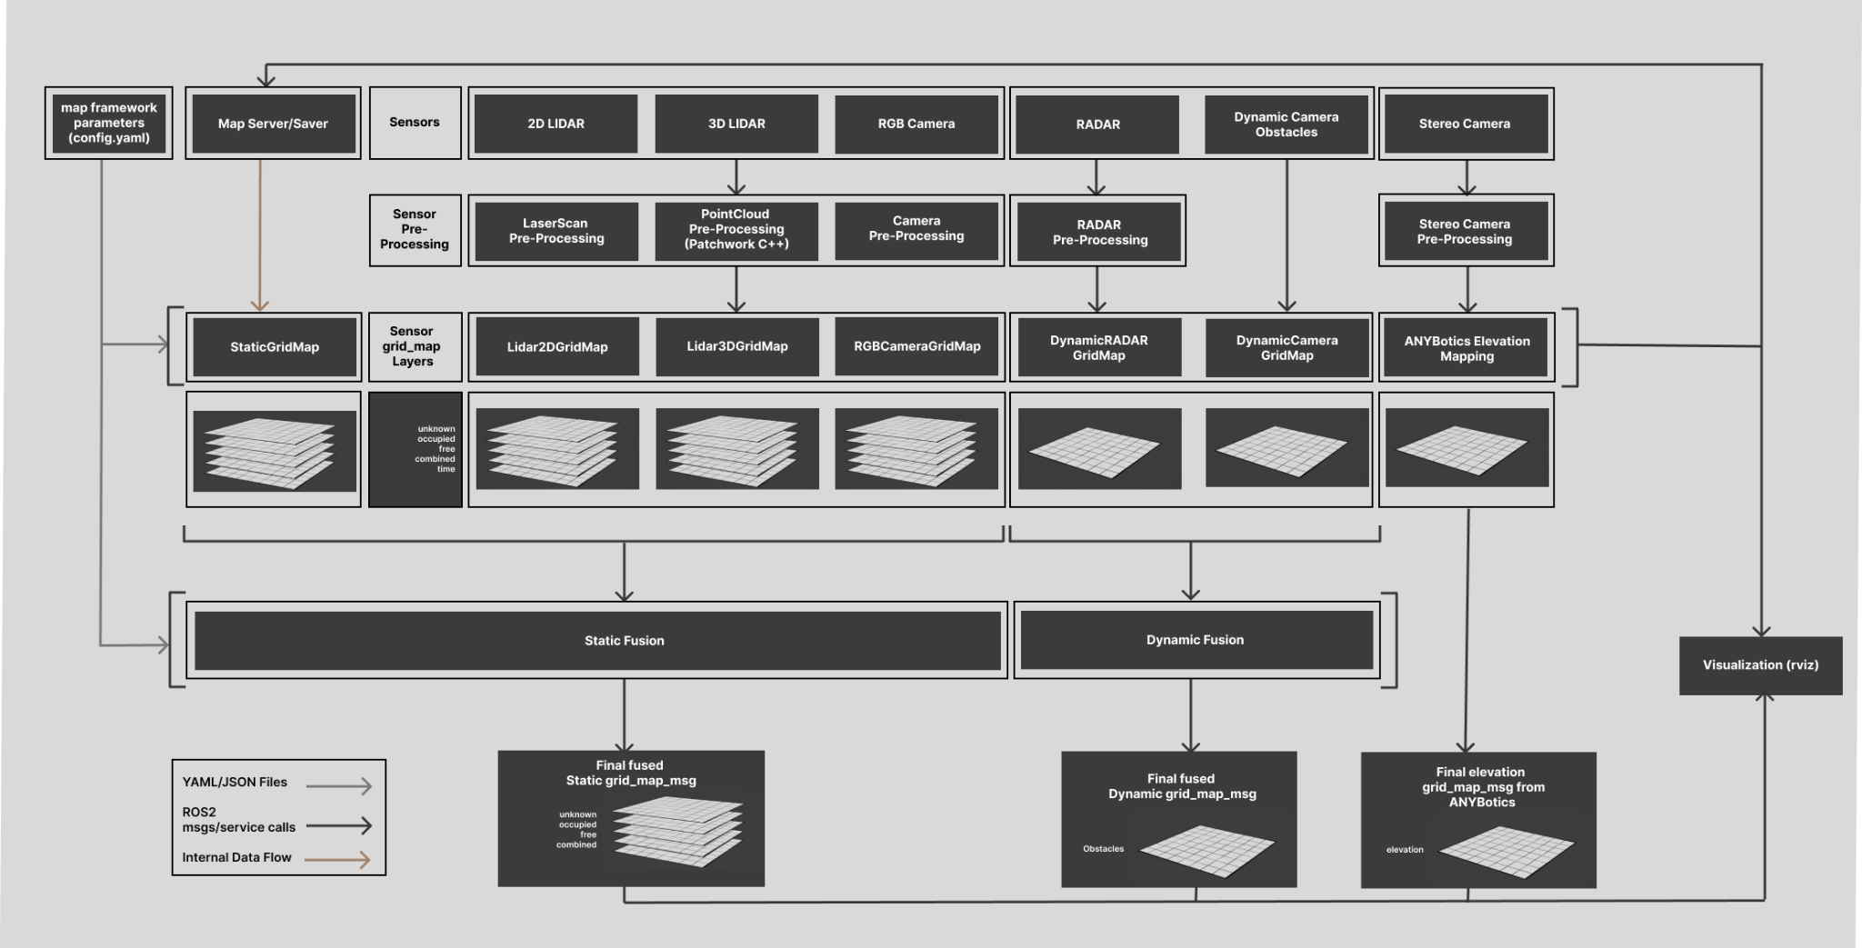
Framework Overview

Slide 7
Framework Overview
Basic Features
ROS2 System
Sensors : 2D and 3D lidar, RGB and stereo cameras, and radar.
Output Gridmaps : static fused, elevation map, and dynamic fused.
Conversion of Lidar and Camera Data
Layers for occupied, free, and unknown
Occupied and free layers represent obstacles and open areas in the environment.
Combined layer created by merging occupied and free layers.
Static Fusion Module
Merges individual lidar and camera gridmaps into a comprehensive static fused gridmap.
Generates combined and unknown layers for a unified representation.
Elevation Map
Stereo camera data used to generate an elevation map with ANYBotics mapping framework.
Dynamic Obstacle Data
Conversion and fusion of dynamic radar and camera obstacle data to gridmaps (further details to be defined)..
User Interface and Configuration
User-friendly configuration files for customizing each module.
Real-Time Visualization
Real-time visualization in RVIZ2 using GridMap RVIZ plugins.

Slide 8
Execution Plan for Activity 3 : High Level Tasks
Implementing a Evidential based Fusion Algorithm
Build on the configurability and ease of adding plugins and new layers.
Testing the framework on a Tomcar
Validating the framework’s performance for each of the test cases
Elevation Map Layer using Docker.

Slide 9
Execution Plan for Activity 3 : Task breakdown
Elevation Map Layer(RCEM) using Docker
Currently the ROS1 RCEM package is deployed using docker images and the messages are being bridged
Issue with RVIZ2 visualization of the bridged messages
Other issues relating to robot pose timestamps
Implementing a Evidential based Fusion Algorithm
Dynamic Camera GridMap
Identify RADAR sensor and corresponding sensor drivers
Look into pre-processing methods
Build Dynamic Camera & Radar Gridmap Node
Dynamic Fusion
Build Dynamic Fusion Node to fuse Dynamic Camera Obstacle data with RADAR data
Build on the configurability and ease of adding plugins and new layers.
Improve the state of the Config files based on the new developments as newer chunks of the framework get added
Increase the ease and readability of code from the perspective of adding custom plugins for New static and dynamic fusion algorithms
Improve the code structure to make it easier to added newer layers
Testing the framework on a Robot
Deploy the framework on a real robot and test the respective modules for their real time performance
Validating the framework’s performance for each of the test cases

Slide 10
Software Components
The Basic Software Components are
map_framework
├── sensors
├── sensor_preprocessing
├── lidar_gridmap
├── camera_gridmap
├── static_fusion
├── dynamic radar_gridmap
├── dynamic_camera_gridmap
├── dynamic_fusion
├── extended_map_server
├── fusionlib
└── filterlib
Sensors
Sensor Pre-Processing
Extended
map
server
Lidar
gridmap
Filter Pluginlib
Filter and Fusion
Pluginlib
MAP FRAMEWORK
Cameragridmap
Fusion Pluginlib
Dynamic
camera
gridmap
Static fusion
Dynamic
radar
gridmap
Notes:
Give to chirag after this

Slide 11
Software Components
Filter Pluginlib Package This component is designed to create a plugins to sequentially process data in layers from gridmap msg.
Provides API to create custom plugins that can be loaded dynamically in runtime
YAML based configuration interface to setup and load plugins chain to process sequentially gridmap layers
Custom Plugins added
Binary Baysin Filter
Inflation Filter
LogOdds
Belief Mass Filter
Normal and Slope Filter
Sensors
Sensor Pre-Processing
Extended
map
server
Lidar
gridmap
Filter Pluginlib
Filter & Fusion
Plugin
Filter and Fusion
Pluginlib
MAP FRAMEWORK
Cameragridmap
Fusion Pluginlib
Dynamic
camera
gridmap
Static fusion
Dynamic
radar
gridmap
Notes:
No need to explain, covered in first milestone

Slide 12
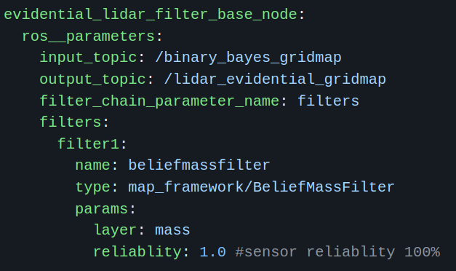
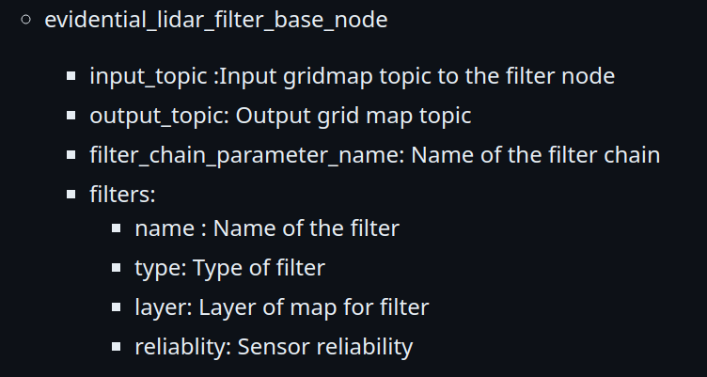
Software Components
Filter Plugin Configurations YAML structure
Notes:
No need to explain, covered in first milestone

Slide 13
Software Components
Fusion Pluginlib Package This component is designed to create a plugins to sequentially fuse multiple gridmap data in layers from gridmap msg.
Provides API to create custom plugins that can be loaded dynamically in runtime
YAML based configuration interface to setup and load plugins to fuse multiple gridmap layers
Custom Plugins added
Evidential Fusion
Log Odds Probability Fusion
Logical AND
Logical OR
Sensors
Sensor Pre-Processing
Extended
map
server
Lidar
gridmap
Filter Pluginlib
Filter & Fusion
Plugin
Filter and Fusion
Pluginlib
MAP FRAMEWORK
Cameragridmap
Fusion Pluginlib
Dynamic
camera
gridmap
Static fusion
Dynamic
radar
gridmap
Notes:
No need to explain, covered in first milestone

Slide 14
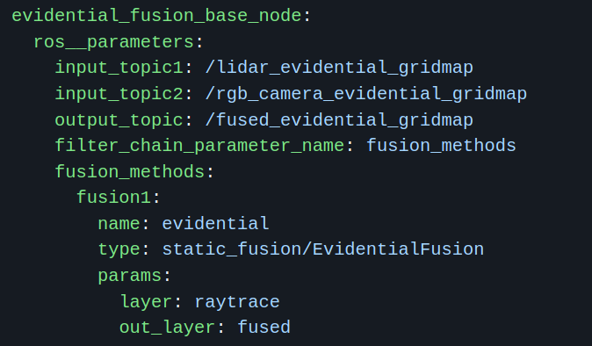
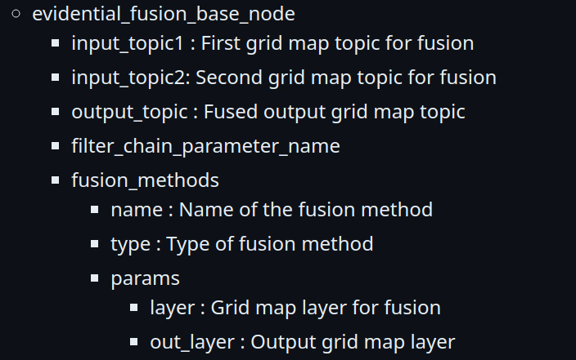
Software Components
Fusion Plugin Configuration YAML structure
Notes:
No need to explain, covered in first milestone

Slide 15
Software Components
Sensors Package This component will be designed to include sensor drivers for Ouster, Velodyne, ZED, Intel RealSense, and USB cameras.
Nodes will be provided for initiating the sensors and capturing sensor data using ROS2 bags.
The package will utilize Component nodes to enhance efficiency, allowing the bundling of multiple nodes into a single process to minimize memory copying or serialization.
Core implementations will be developed for essential components such as Image and PointCloud2, providing a consistent approach to handling sensor data.
Designed to be model agnostic, the packages will ensure interfaces for sensor data that can support easy extension and accommodate changes in sensors, models, or data processing methods.
Sensors
Sensor Pre-Processing
Extended
map
server
Lidar
gridmap
Filter Pluginlib
Filter and Fusion
Pluginlib
MAP FRAMEWORK
Cameragridmap
Fusion Pluginlib
Dynamic
camera
gridmap
Static fusion
Dynamic
radar
gridmap
Notes:
No need to explain, covered in first milestone

Slide 16
Software Components
Sensor Pre-Processing Package
Preprocessing modules optimize sensor data quality for gridmap construction.
Data filtering with advanced outlier rejection and noise reduction algorithms ensures data integrity.
Calibration procedures align sensor measurements with the system's reference frame for spatial correspondence.
Data transformations include coordinate system conversions and format adaptations for seamless integration with downstream modules.
These steps contribute to generating precise and reliable gridmaps.
The preprocessing modules are crucial for robust and effective robot navigation.
Sensors
Sensors pre-Processing
Sensor Pre-Processing
Extended
map
server
Lidar
gridmap
Filter Pluginlib
Filter and Fusion
Pluginlib
MAP FRAMEWORK
Cameragridmap
Fusion Pluginlib
Dynamic
camera
gridmap
Static fusion
Dynamic
radar
gridmap
Notes:
Covered in first milestone

Slide 17
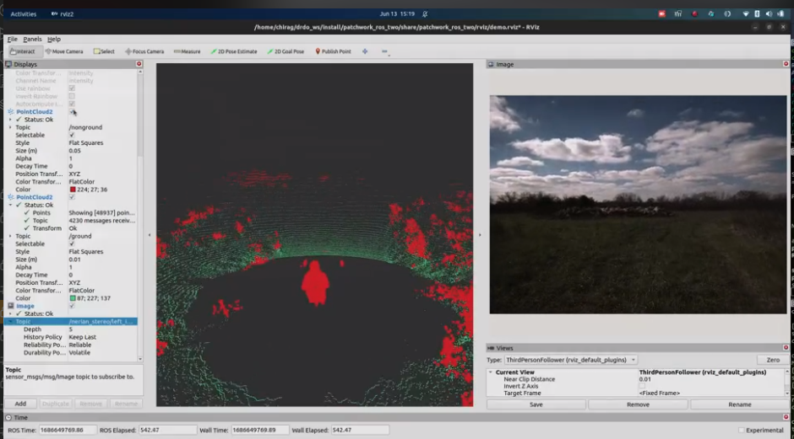
Results : Sensor Pre-Processing (LIDAR 3D)

Slide 18
Software Components
LIDAR Gridmap Package
This package will handle the conversion of both 2d and 3D LIDAR data to gridmaps. The general procedure followed is delineated below.
To initialize a grid map, the size and resolution of the map need to be specified. The size of the map corresponds to the number of cells in each dimension, while the resolution refers to the distance between each cell.
When loading lidar data into the grid map, the frame of reference for the lidar data must be provided. This frame of reference defines the coordinate system in which the lidar data is represented.
Sensors
Sensor Pre-Processing
Extended
map
server
Lidar Gridmap
Lidar
gridmap
Filter Pluginlib
Filter and Fusion
Pluginlib
MAP FRAMEWORK
Cameragridmap
Fusion Pluginlib
Dynamic
camera
gridmap
Static fusion
Dynamic
radar
gridmap

Slide 19
Software Components
LIDAR Gridmap Package contd.
The LIDAR 3D Node takes an input pointcloud and generates a costmap. The output from the respective pre processing node is taken as input
The LIDAR 2D Node takes a laserscan topic and generates a costmap.
The Mapping filling algorithm used is LoggOdds.
Each Map has three main layers
Occupied
Free
Combined
Sensors
Sensor Pre-Processing
Extended
map
server
Lidar Gridmap
Lidar
gridmap
Filter Pluginlib
Filter and Fusion
Pluginlib
MAP FRAMEWORK
Cameragridmap
Fusion Pluginlib
Dynamic
camera
gridmap
Static fusion
Dynamic
radar
gridmap

Slide 20
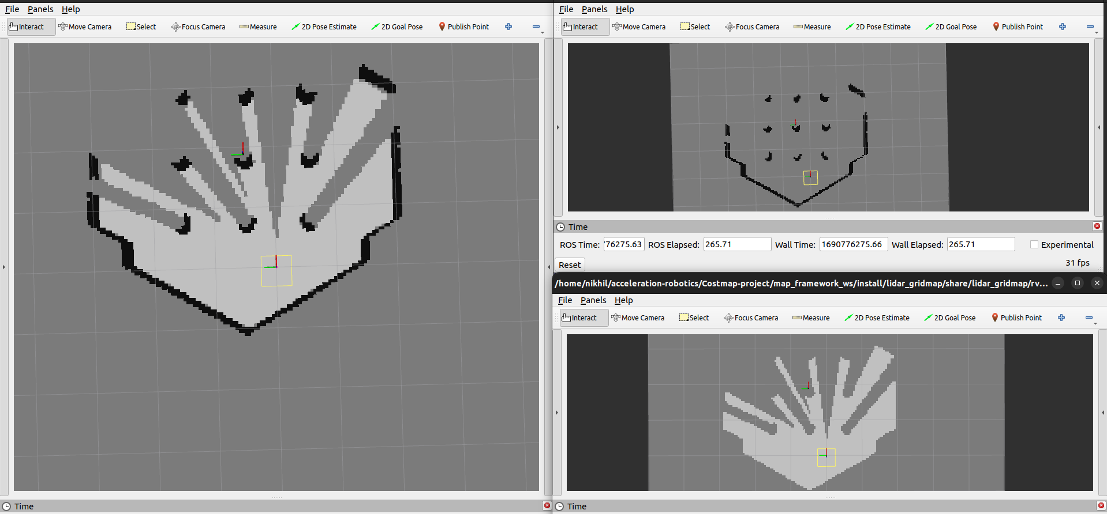
Results : LIDAR 2D GridMap

Slide 21
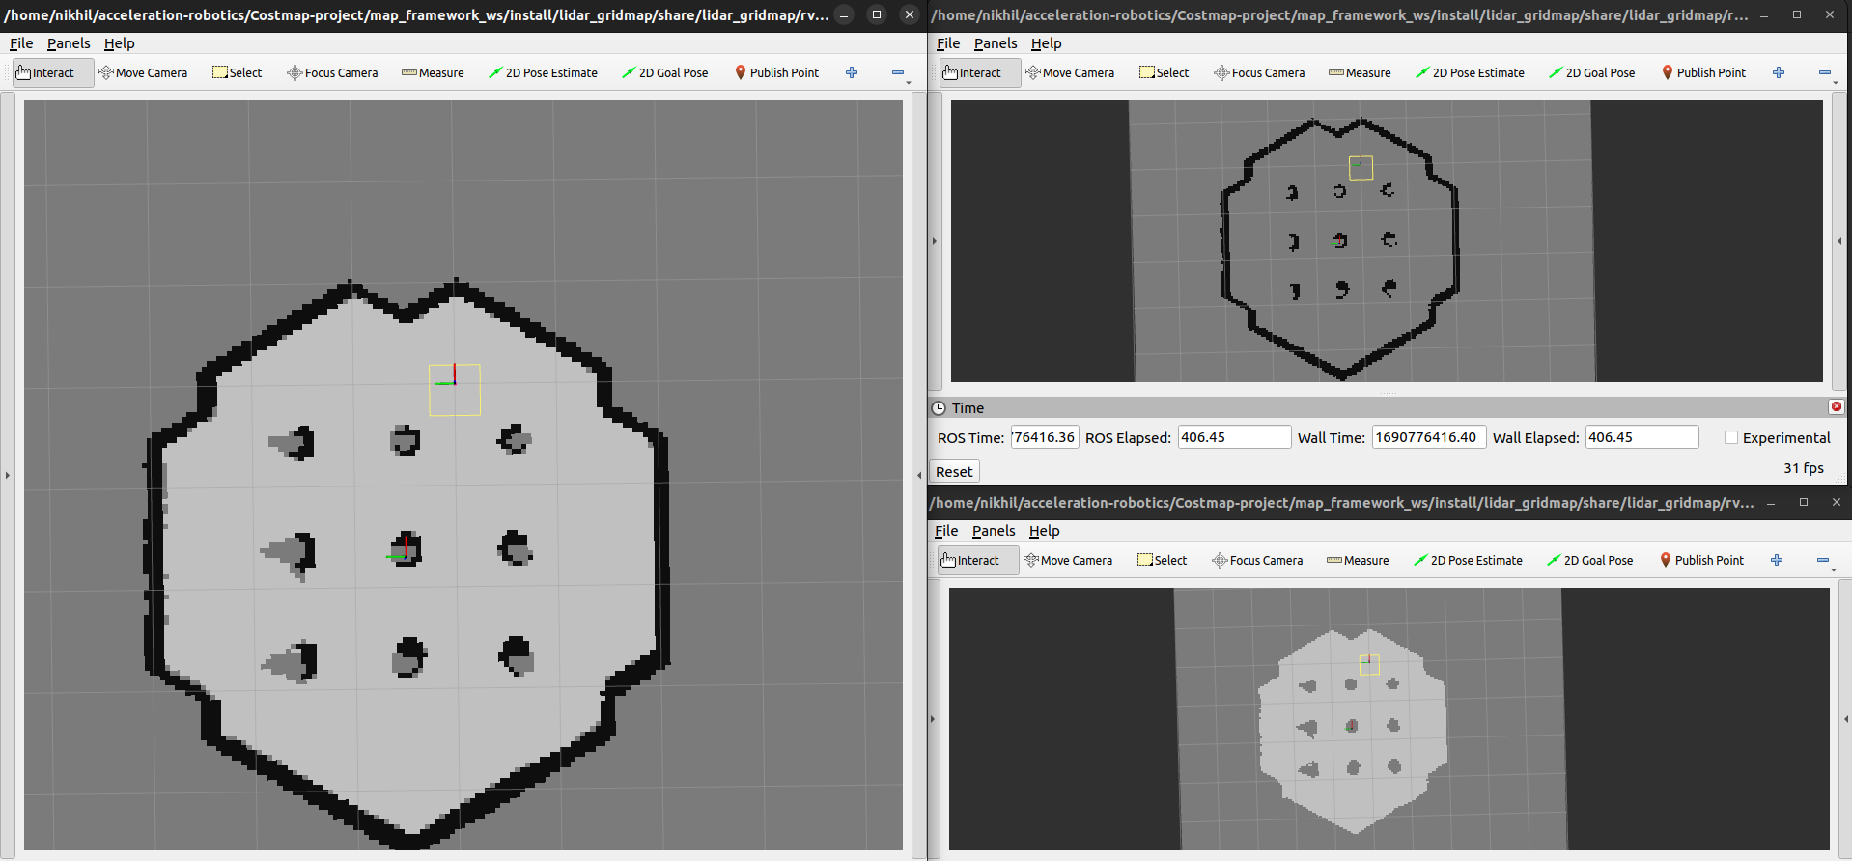
Results : LIDAR 2D GridMap

Slide 22
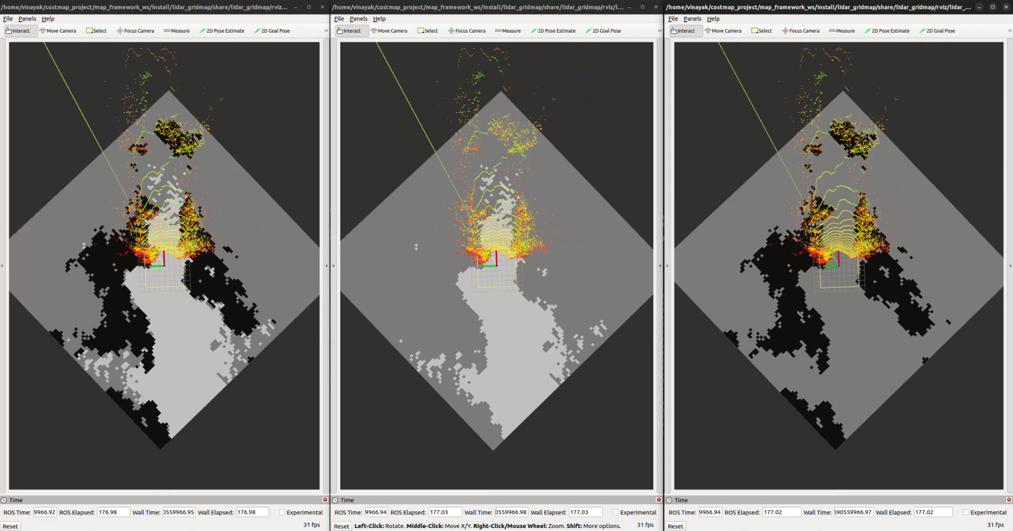
Results : LIDAR 3D GridMap - Desert ros2 bag

Slide 23
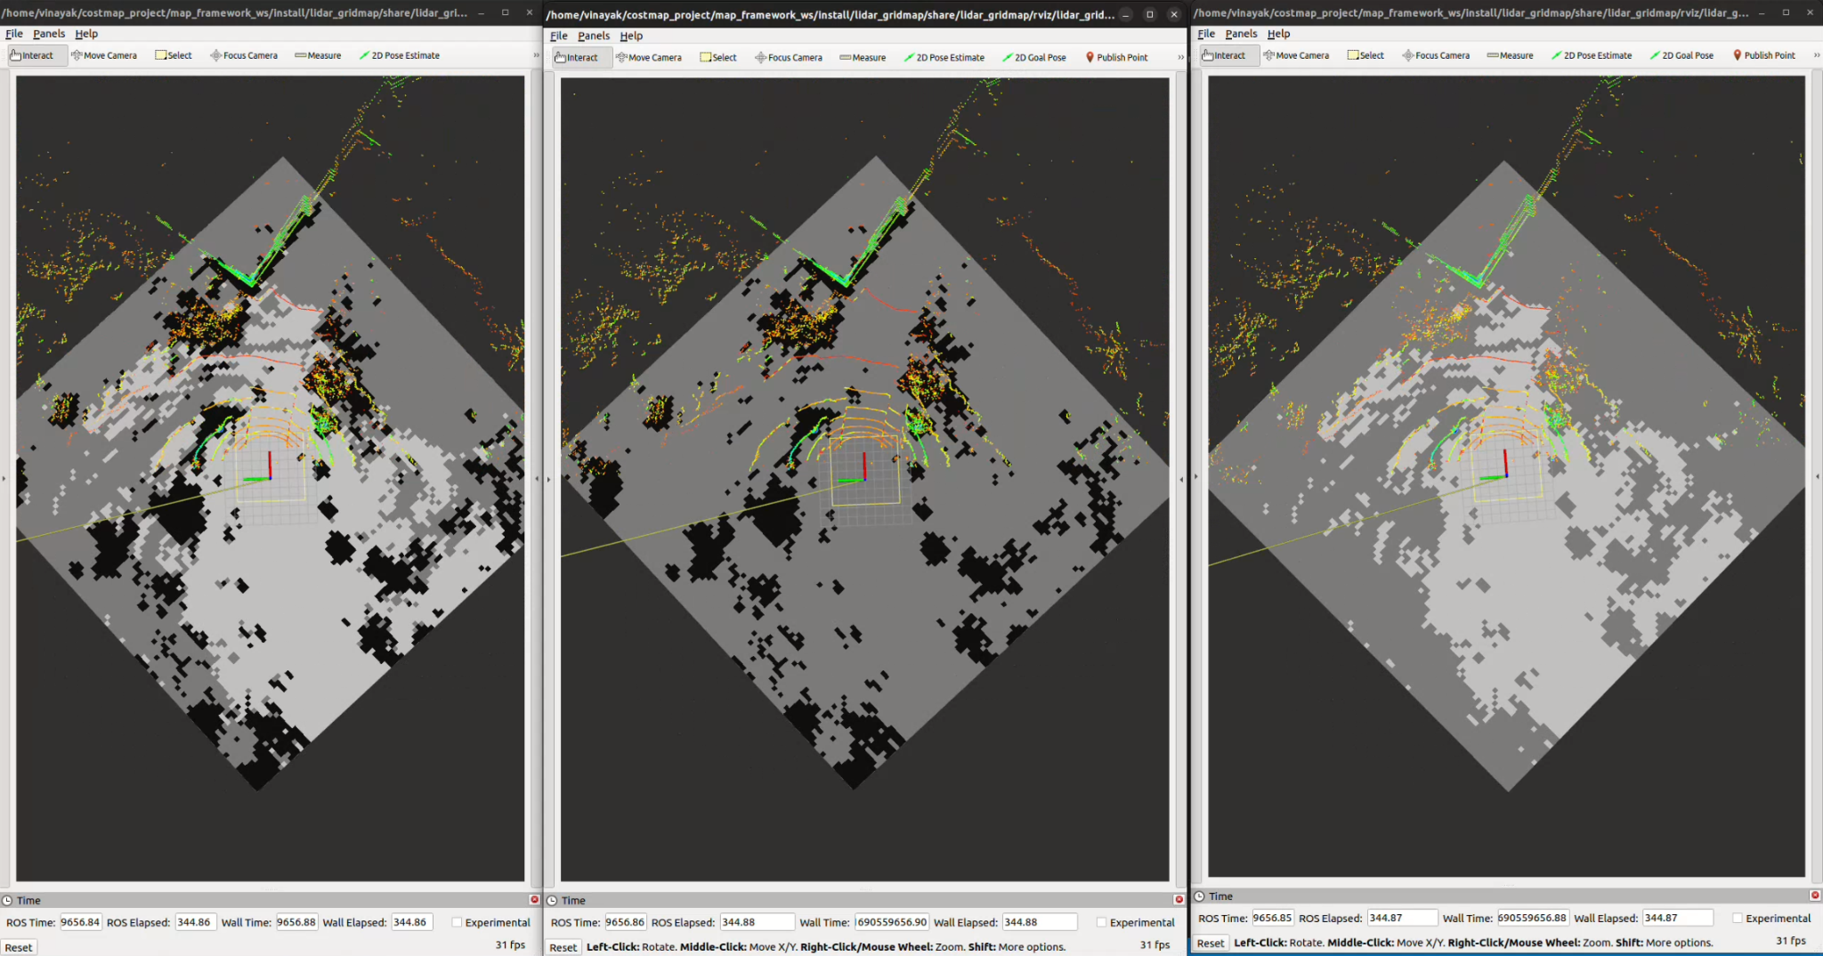
Results : LIDAR 3D GridMap - Road ros2 bag

Slide 24
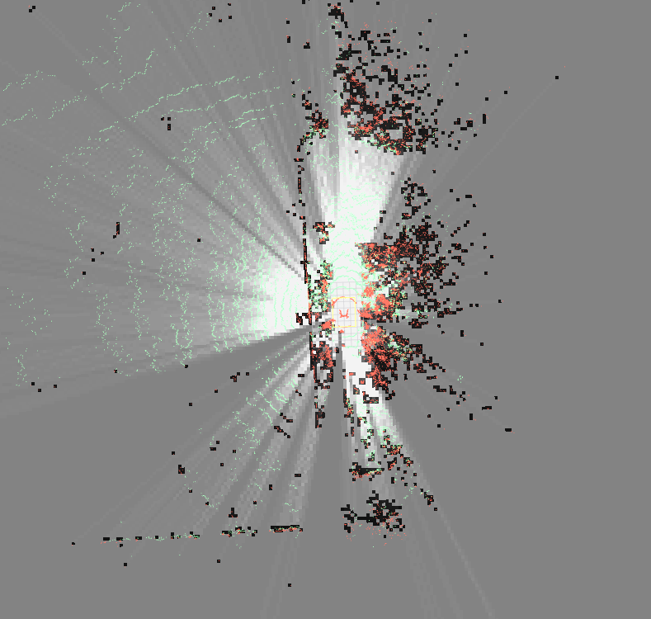
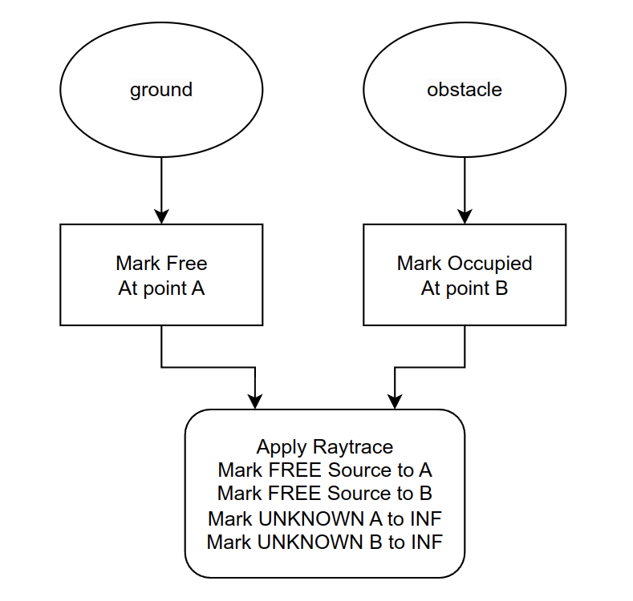
Results : LIDAR 3D GridMap
Improvement: Raytracing implementation
Reduces effect of noise in traversable path
Fast coverage of map for Occupied, Free and Unknown space.
It resolves the conflict whether space is free or occupied in case if Laser ray able passed through that space
Unknown
Obstacle
Occupied cell
raycast
Notes:
Raytracing
Why we added it
What benefit does it provide
How did we do it
Vinayk sir will play clip

Slide 25
Software Components
Camera Gridmap Package
This package will handle the conversion of rgb camera data to gridmaps. The general procedure followed is delineated below.
To initialize a grid map, the size and resolution of the map need to be specified. The size of the map corresponds to the number of cells in each dimension, while the resolution refers to the distance between each cell.
When loading the camera data into the grid map, the frame of reference for the lidar data must be provided. This frame of reference defines the coordinate system in which the lidar data is represented.
Sensors
Sensor Pre-Processing
Extended
map
server
Lidar
gridmap
Filter Pluginlib
Filter and Fusion
Pluginlib
MAP FRAMEWORK
Camera Gridmap
Cameragridmap
Fusion Pluginlib
Dynamic
camera
gridmap
Static fusion
Dynamic
radar
gridmap

Slide 26
Software Components
Camera Gridmap Package
The RGB Camera node takes in two pre processed input pointclouds - ground and non ground and builds a map using them.
The map filling algorithm used here is LoggOdds
The Camera GridMap like the other maps has three main layers
Occupied
Free
Combined
Sensors
Sensor Pre-Processing
Extended
map
server
Lidar
gridmap
Filter Pluginlib
Filter and Fusion
Pluginlib
MAP FRAMEWORK
Camera Gridmap
Cameragridmap
Fusion Pluginlib
Dynamic
camera
gridmap
Static fusion
Dynamic
radar
gridmap

Slide 27
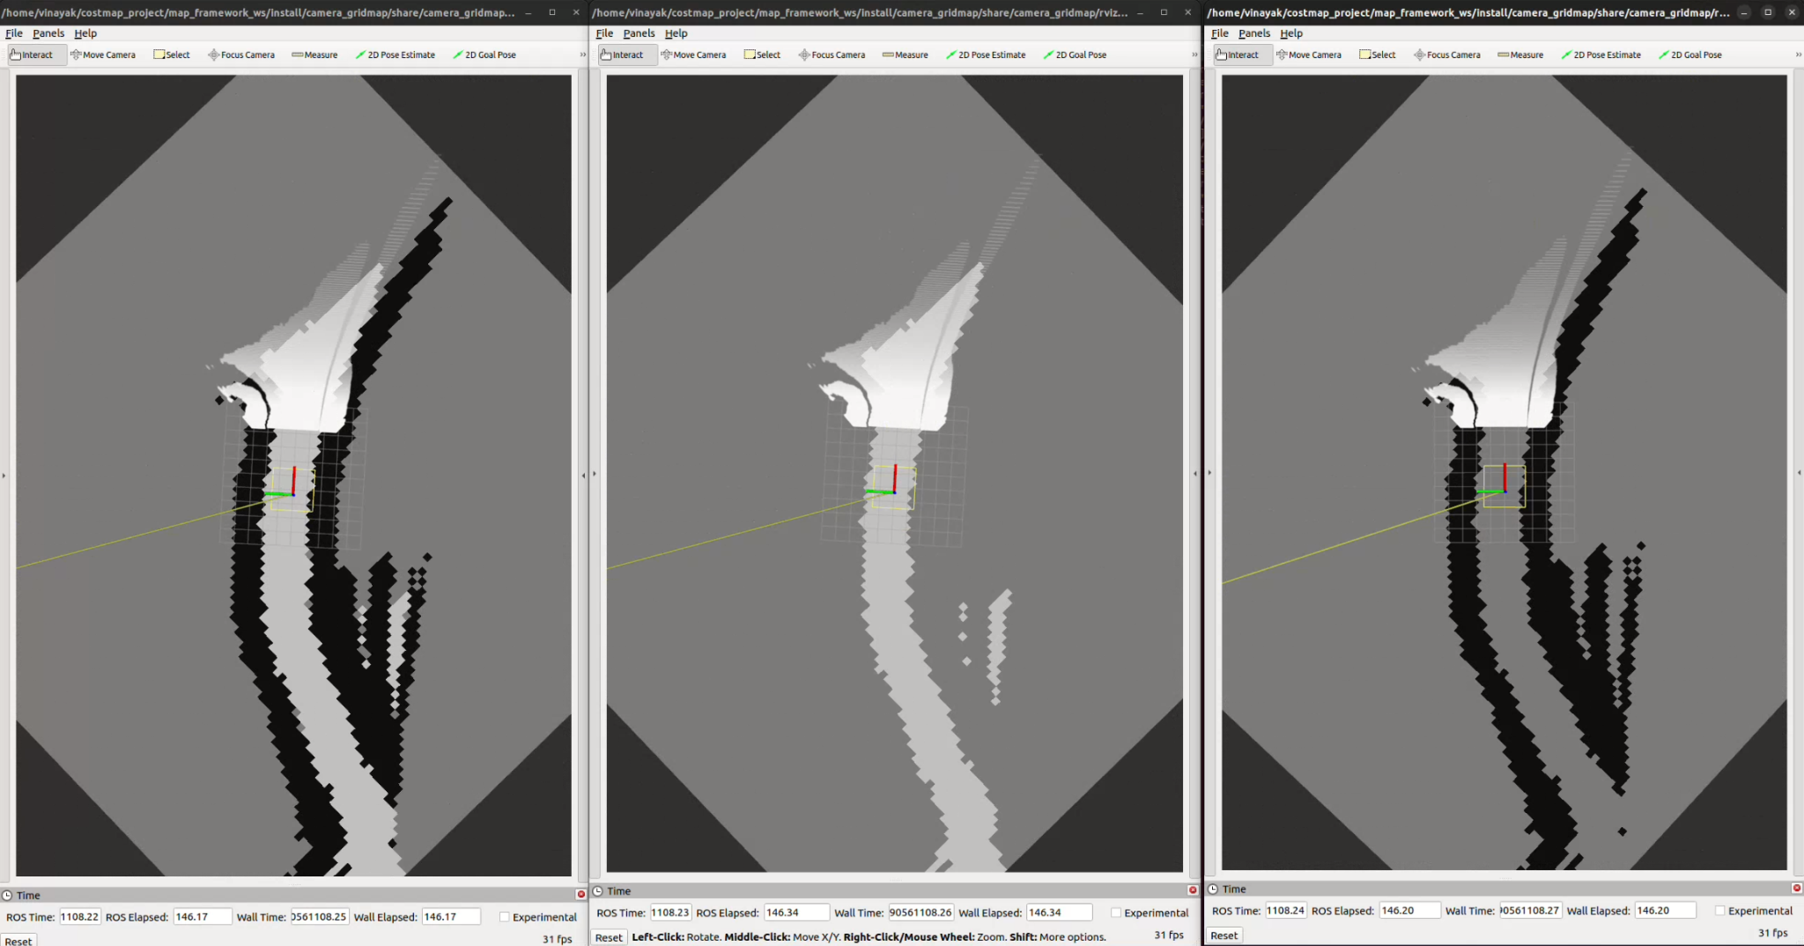
Results : RGB Camera GridMap

Slide 28
Software Components
Dynamic Camera Gridmap Package
Converts dynamic obstacle data from cameras into gridmaps.
Implements necessary algorithms and modules for the conversion process.
Takes in obstacle data with predicted trajectory information and builds a map
A ros2 service request has to be sent for the predicted trajectories into the map
Sensors
Sensor Pre-Processing
Extended
map
server
Lidar
gridmap
Filter Pluginlib
Filter and Fusion
Pluginlib
MAP FRAMEWORK
Cameragridmap
Fusion Pluginlib
Dynamic
camera
gridmap
Dynamic Camera Gridmap
Static Fusion
Dynamic
radar
gridmap

Slide 29
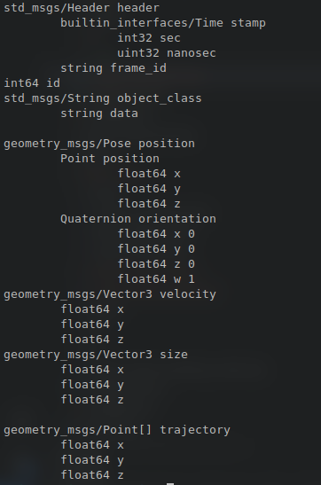
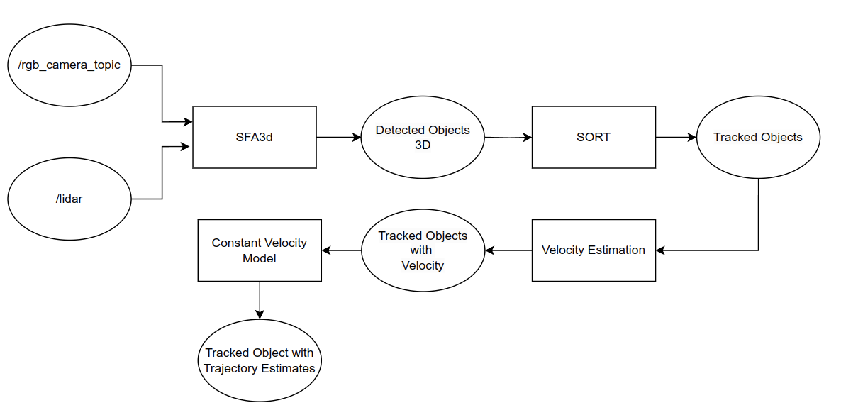
Dynamic Camera GridMap
Dynamic Camera Gridmap Preprocessing

Slide 30
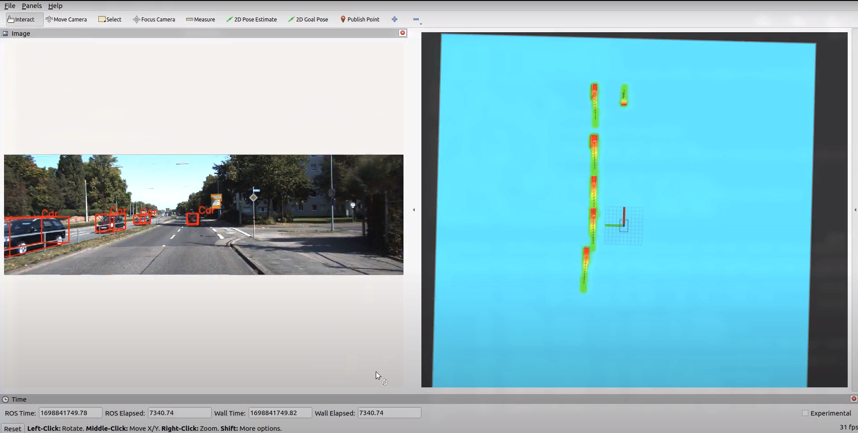
Results : Dynamic Camera GridMap using KITTI Dataset
Detected Objects with
Bounding Box
Predicted trajectory
Gaussian distribution
Detected Objects gridmap
Vehicle Position

Slide 31
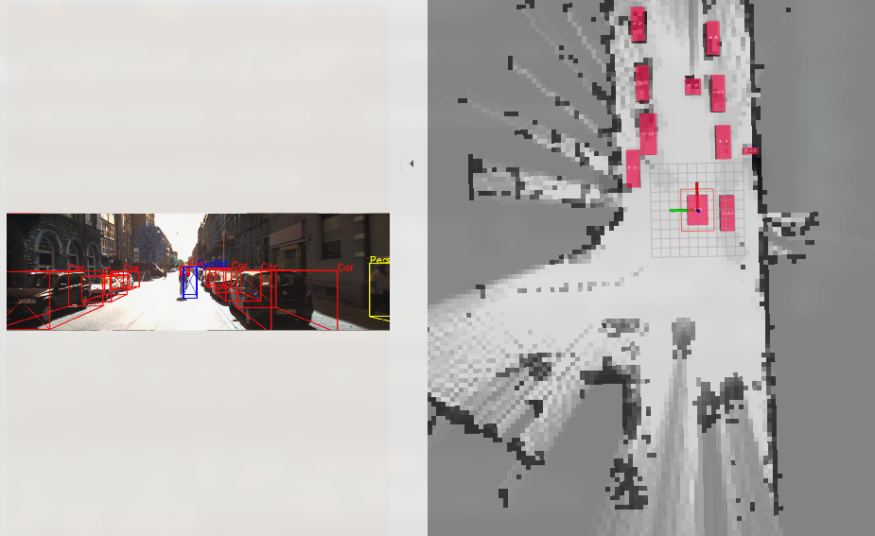
Results : Dynamic Camera GridMap using KITTI Dataset
Detected Objects gridmap
Detected Objects with
Bounding Box
Vehicle Position

Slide 32
Results : Dynamic Camera GridMap using Prolients tracking on Tomcar

Slide 33
Software Components
Static Fusion Package
Implements static sensor fusion by combining data from the map server, lidar gridmaps, and RGB camera gridmaps.
Generates a fused static gridmap that includes four layers: occupied, free, combined, and unknown.
Integrates the individual gridmaps to create a comprehensive static representation of the environment.
Assigns specific cost values within the gridmap representation:
'Occupied' cells are given a value of 255.
'Free' cells are assigned a value of 0.
'Unknown' cells are assigned a value of 150.
Cells without a specific meaning are given a value of -1.
Sensors
Sensor Pre-Processing
Extended
map
server
Lidar
gridmap
Filter Pluginlib
Filter & Fusion
Pluginlib
MAP FRAMEWORK
Cameragridmap
Fusion Pluginlib
Dynamic
camera
gridmap
Static
Fusion
Fusion
Pluginlib
Dynamic
radar
gridmap

Slide 34
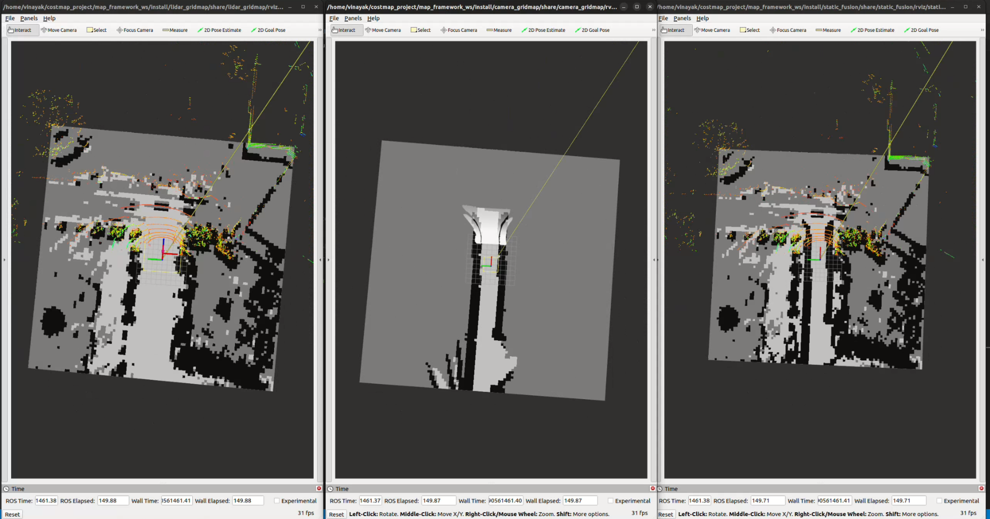
Results : Static Fusion GridMap

Slide 35
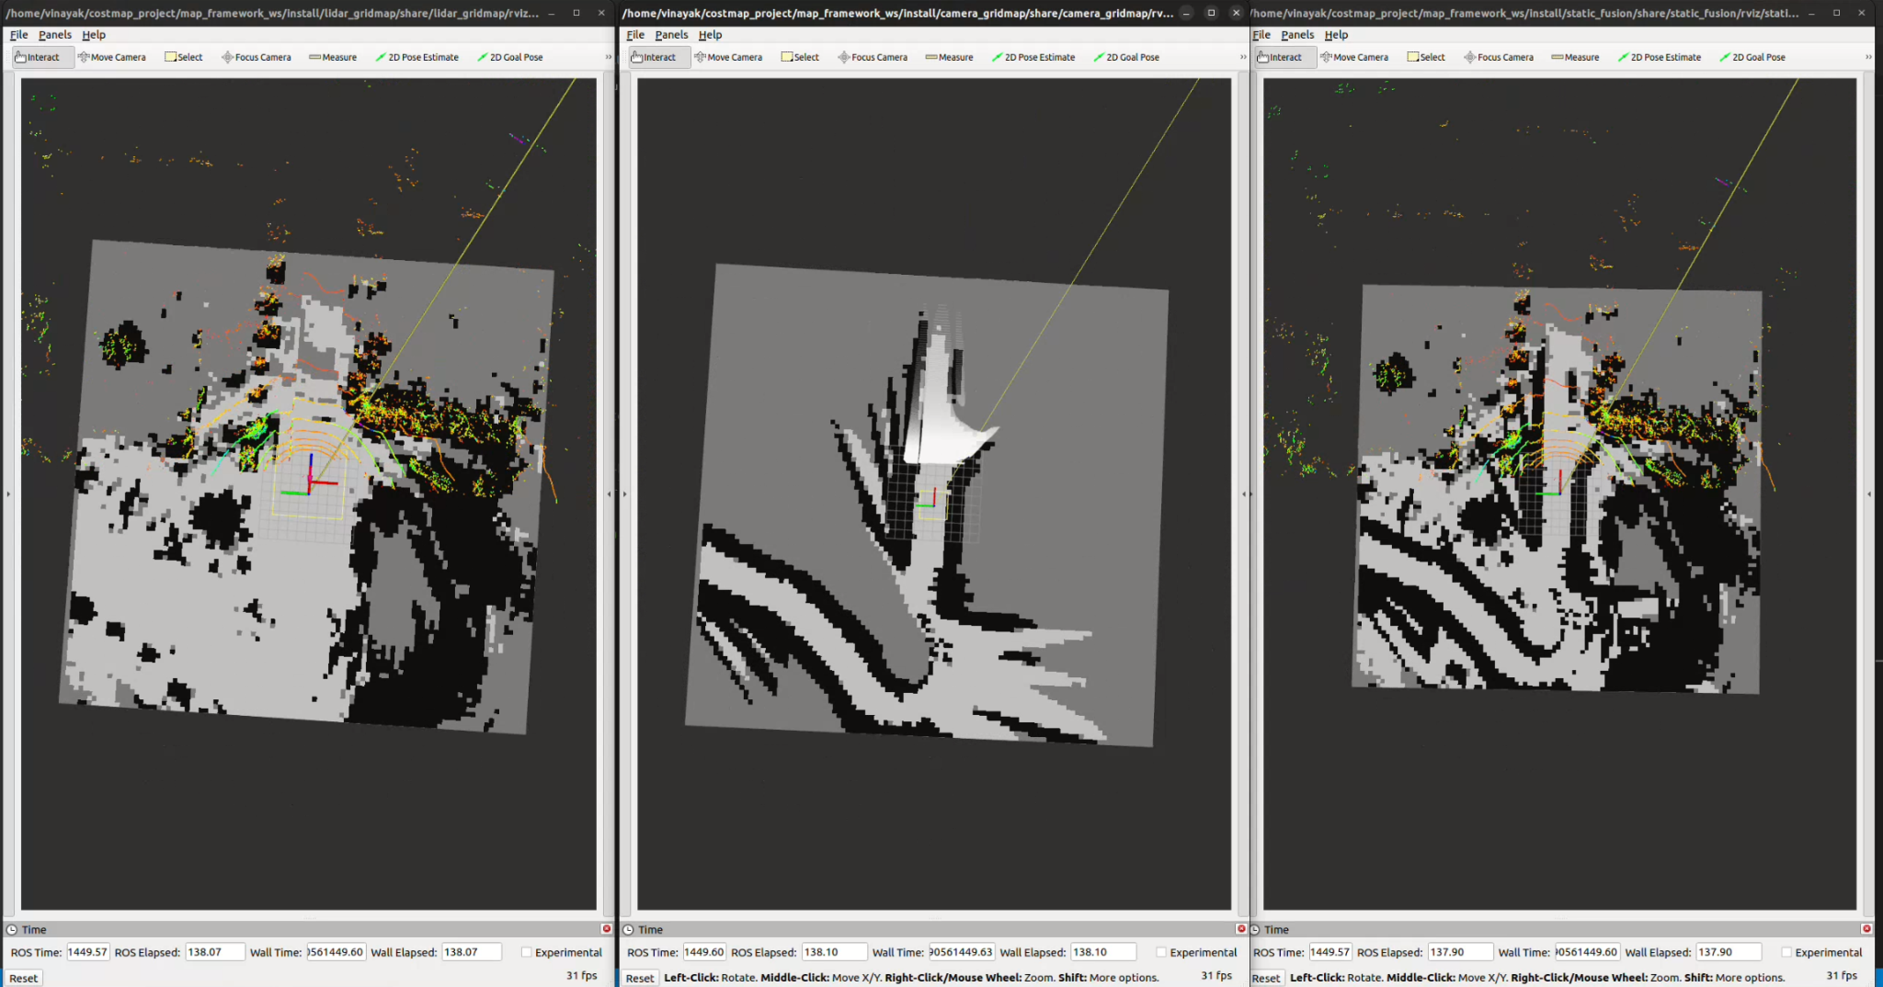
Results : Static Fusion GridMap

Slide 36
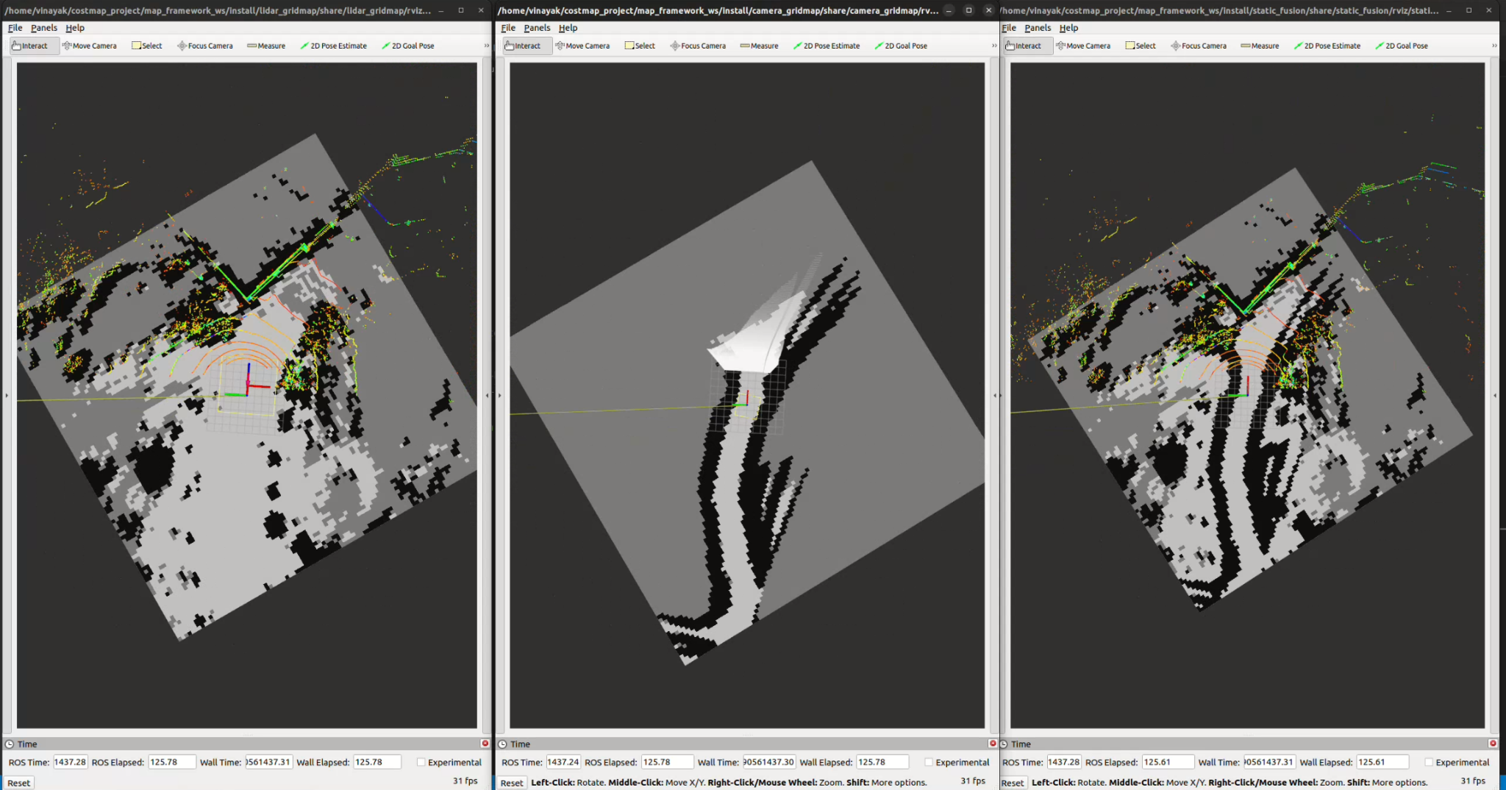
Results : Static Fusion GridMap

Slide 37
Static Fusion GridMap
Probabilistic Fusion: LogOdds
Integrated probabilistic fusion algorithm “LogOdds” with the framework along with logical OR and Logical AND methods.
Fusion method can be used by setting parameter “static_fusion_gridmap_node/fusion” with value “LOGODDS_PROB”
This method uses the sensor-level logodds values converted to probability using the equation
P_occupied = (exp ^ logodds) / (1 +(exp ^ logodds))
P_free = 1- P_occupied
Notes:
Logodds
Vinayk sir will play clip

Slide 38
Result- Static Fusion GridMap
Add images
Notes:
Logodds
Vinayk sir will play clip

Slide 39
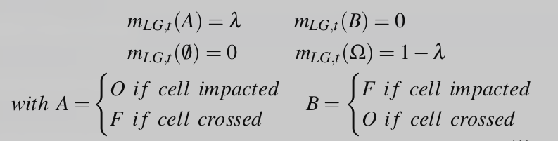
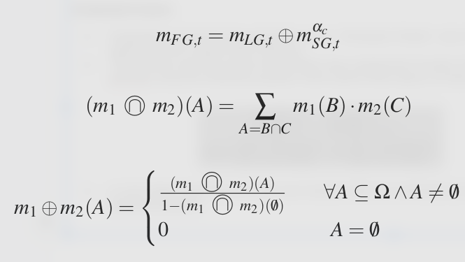
Static Fusion GridMap
Evidential Fusion:
Integrated evidential fusion algorithm using “Dempster Shafer” rule of combination with the framework along with logical OR and Logical AND methods.
This method uses the sensor-level belief mass assignment function through BeliefMassFilter plugin for each sensor gridmap using the following equation which gives three layers of mass where λ represents confidence of sensor.
In next stage Laser Scanner grid and Camera Grid are combined by Dempster shafer rule of combination using following equation
Notes:
Logodds
Vinayk sir will play clip

Slide 40
Result- Static Fusion GridMap
Add images
Notes:
Logodds
Vinayk sir will play clip

Slide 41
Software Components
Extended Map Server Package
Extend ROS2 Map Server with WGS 84 geographic coordinates in YAML metadata.
YAML Metadata File Update:
Add "geo_information" section for storing latitude and longitude values.
Augment existing parameters like yaml_filename, save_map_timeout, free_thresh_default, and occupied_thresh_default.
Map Server Code Modification:
Update source code to load and process geographic parameters from YAML file.
Integrate logic within MapServer::on_configure() function or equivalent.
MongoDB integration:
Adding mongodb server client instance in MapSaverNode to extend map server-saver node with storing and querying gridmaps in mongodb
Integration of GeoSpecial queries to save and load gridmap along with geolocation
Sensors
Sensor Pre-Processing
Map Storage-Retrieval
Extended
map
server
Lidar
gridmap
Filter Pluginlib
Filter & Fusion
Pluginlib
MAP FRAMEWORK
Cameragridmap
Fusion Pluginlib
Dynamic
camera
gridmap
Fusion
Pluginlib
Dynamic
radar
gridmap
Notes:
MongoDB is a source-available cross-platform document-oriented database program. Classified as a NoSQL database program, MongoDB uses JSON-like documents with optional schemas

Slide 42
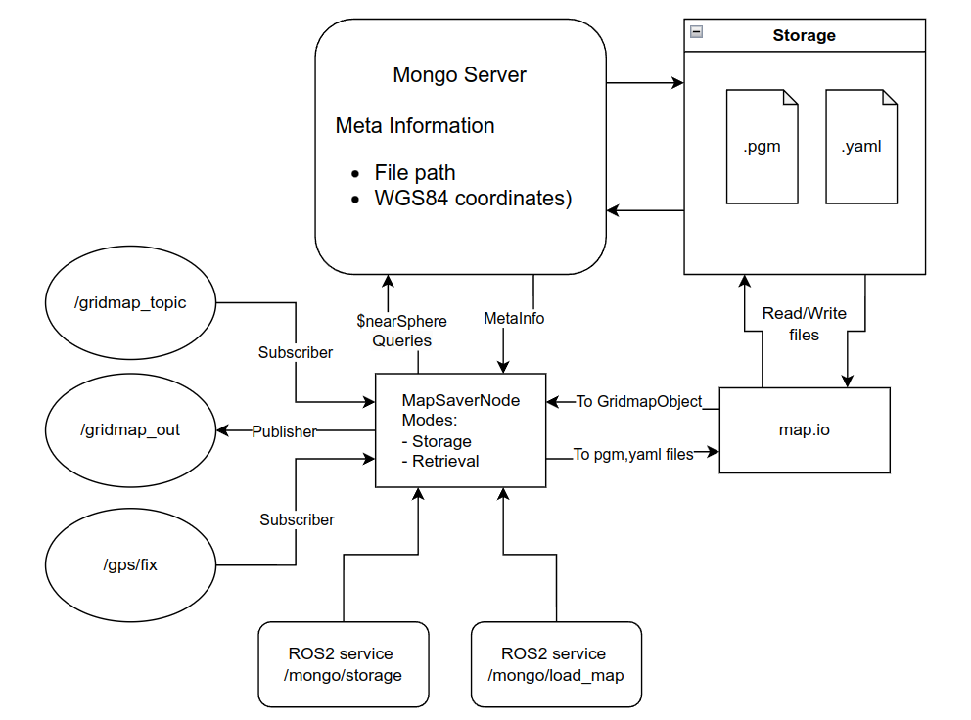
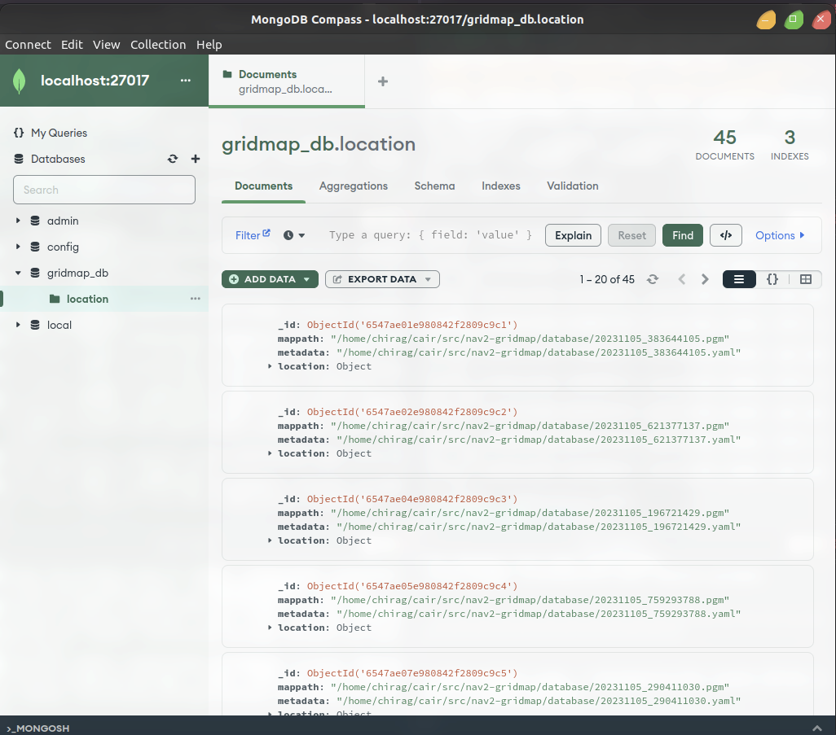
Feature: Extended Map Server

Slide 43
Feature: Extended Map Server
Extended Map Server Modes
Storage Mode :
Submap Retrieval Mode
GlobalMap Retrieval Mode

Slide 44
GridMap Aggregation
The gridmaps stored in the database, when retrieved or when called, are taken in and aggregated to form a lifelong gridmap.
The position and orientation informations from the grid map message are utilised for the aggregation.
The size of the lifelong grid along with other map elements are parameterized to accommodate varied datasets.

Slide 45
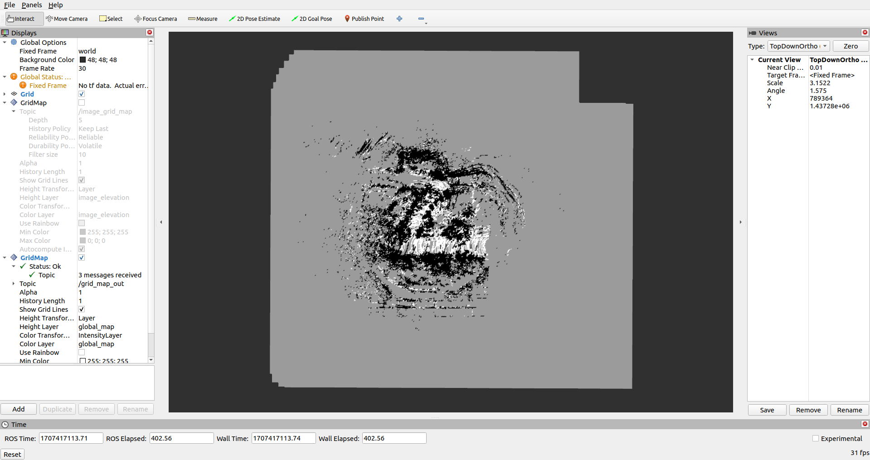
Aggregated GridMap - Combined Layer

Slide 46
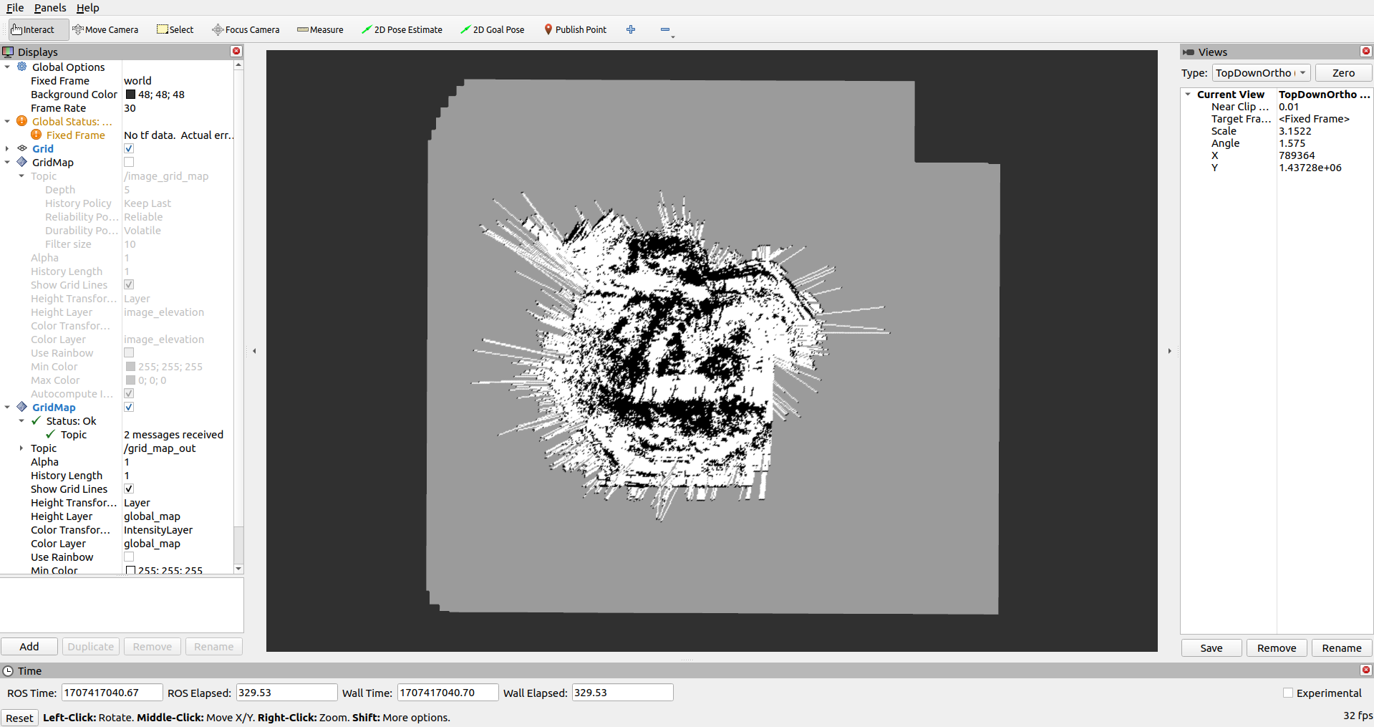
Aggregated GridMap - Raytrace Layer

Slide 47
Elevation Mapping
This package is developed for elevation mapping with a mobile robot.
The package is designed for (local) navigation tasks with robots which are equipped with a pose estimation.
The provided elevation map is around the robot and reflects the pose uncertainty that is aggregated through the motion of the robot (robot-centric mapping).
This method is introduced to explicitly handle drift of the robot pose estimation.

Slide 48
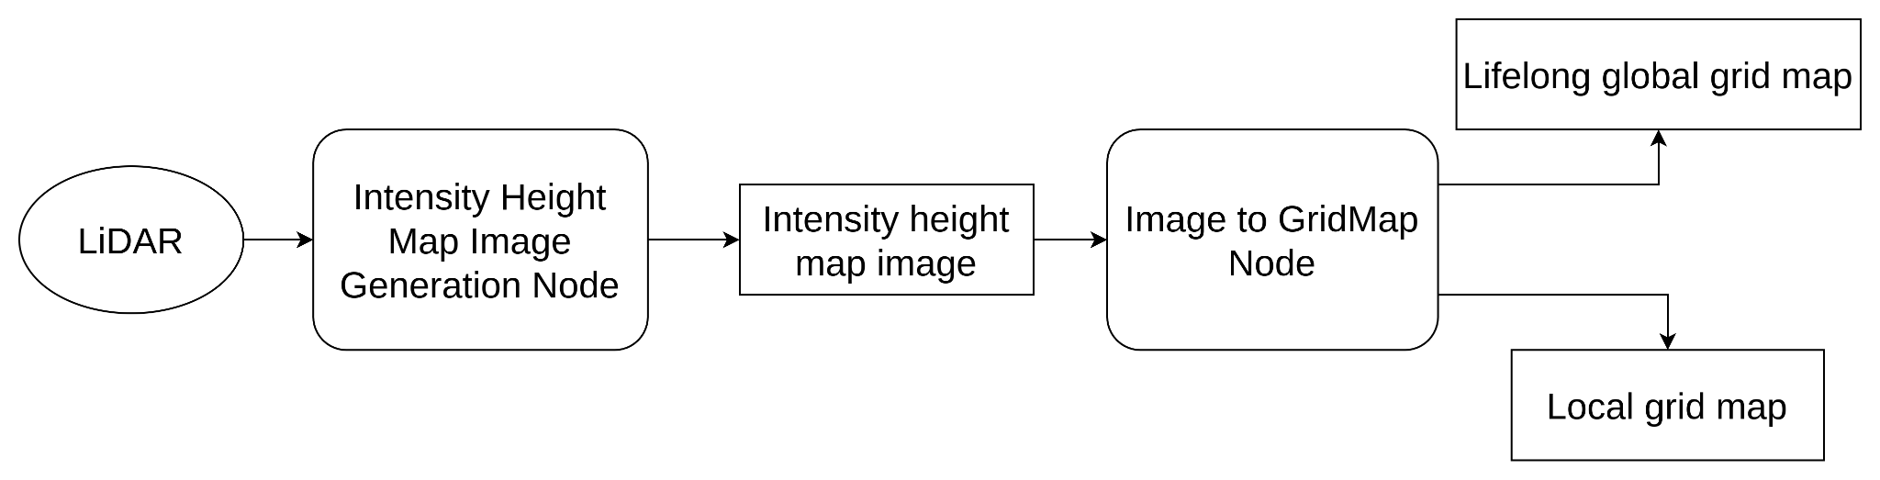
Image based GridMap
The proposed approach utilises the LiDAR point cloud to generate intensity height map image.
The intensity height map image contains height information stored as intensity value in the pixels.
The image is then converted into elevation based grid map.
A global life long grid along with a local rolling window grid are generated.
Point cloud

Slide 49
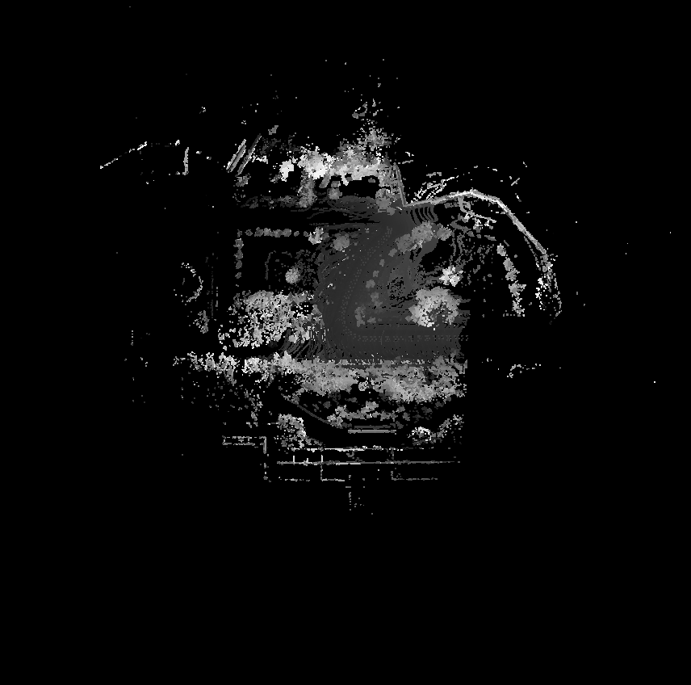
Height map image generated from Lidar point cloud

Slide 50
Static Testing results
Package | Lint Test Result (No. of errors and warnings) |  |  | Post correction Inference
 | cmake | cpp | yaml
camera_gridmap | 7 | 17 | 10 | Corrected errors and warnings including codestyling errors
lidar_gridmap | 9 | 41 | 24 | Corrected errors and warnings including codestyling errors
static_fusion | 7 | 16 | 44 | Corrected errors and warnings including codestyling errors
dynamic_fusion | 0 | 15 | 2 | Corrected errors and warnings including codestyling errors
map_framework | 7 | 12 | 0 | Corrected errors and warnings including codestyling errors
extended_map_server | 12 | 33 | 10 | Corrected errors and warnings including codestyling errors

Slide 51
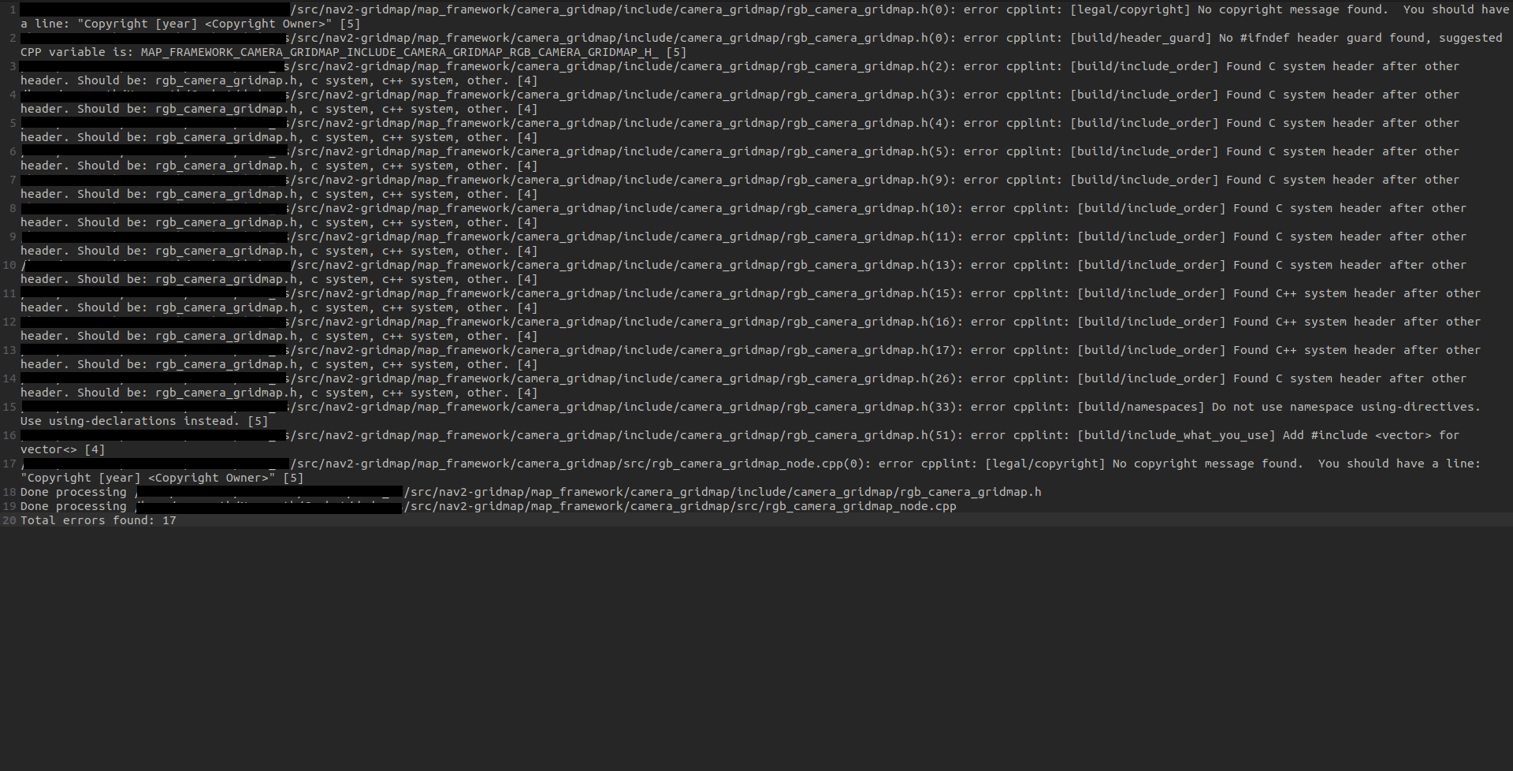
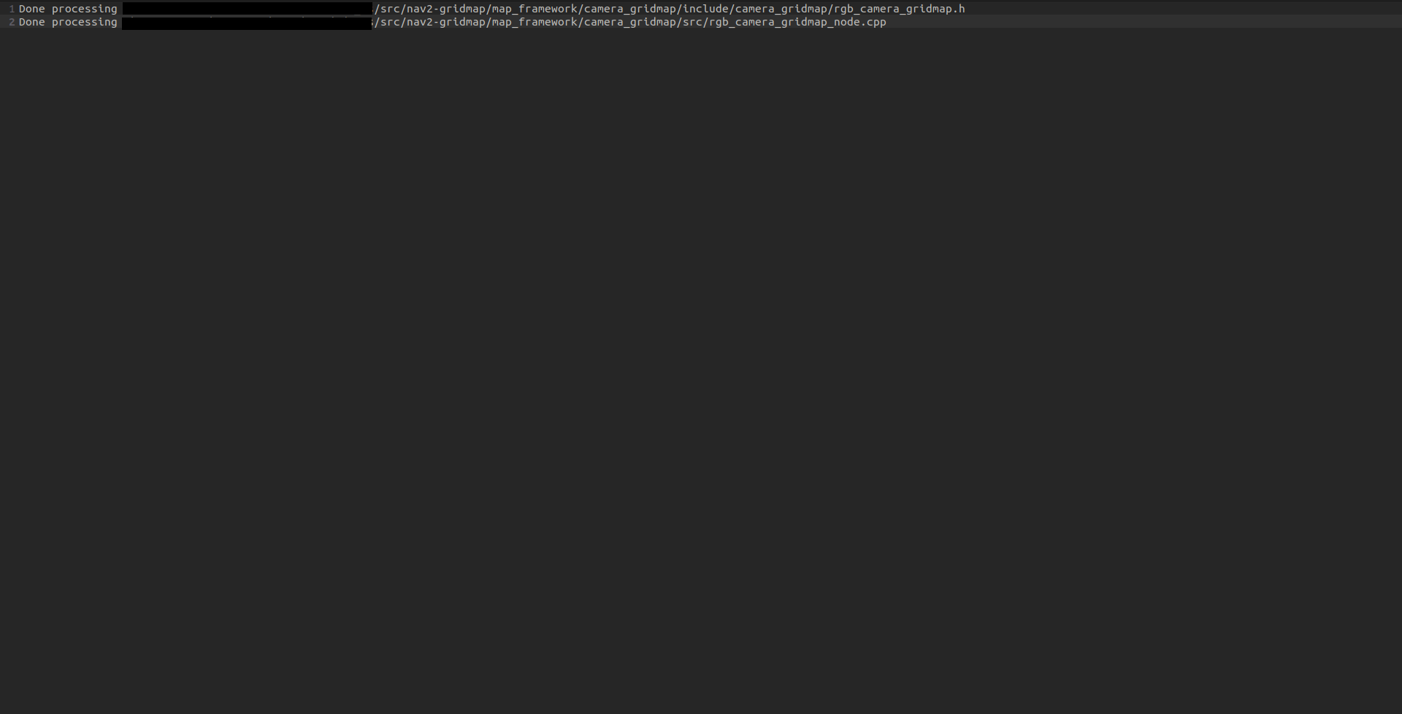
Static cpplint test result : RGB Camera Grid-map Node
Cpplint errors
Post cpplint correction

Slide 52
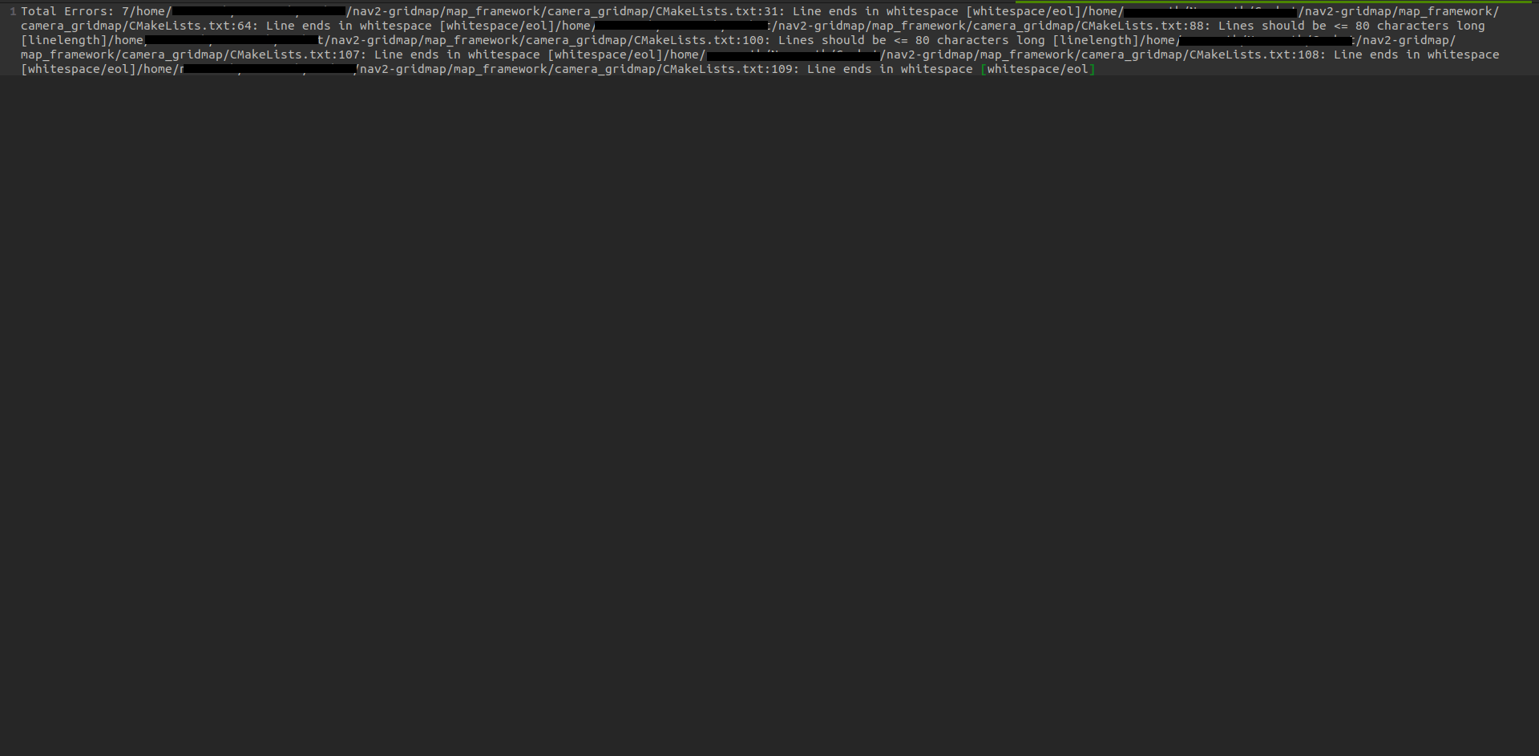
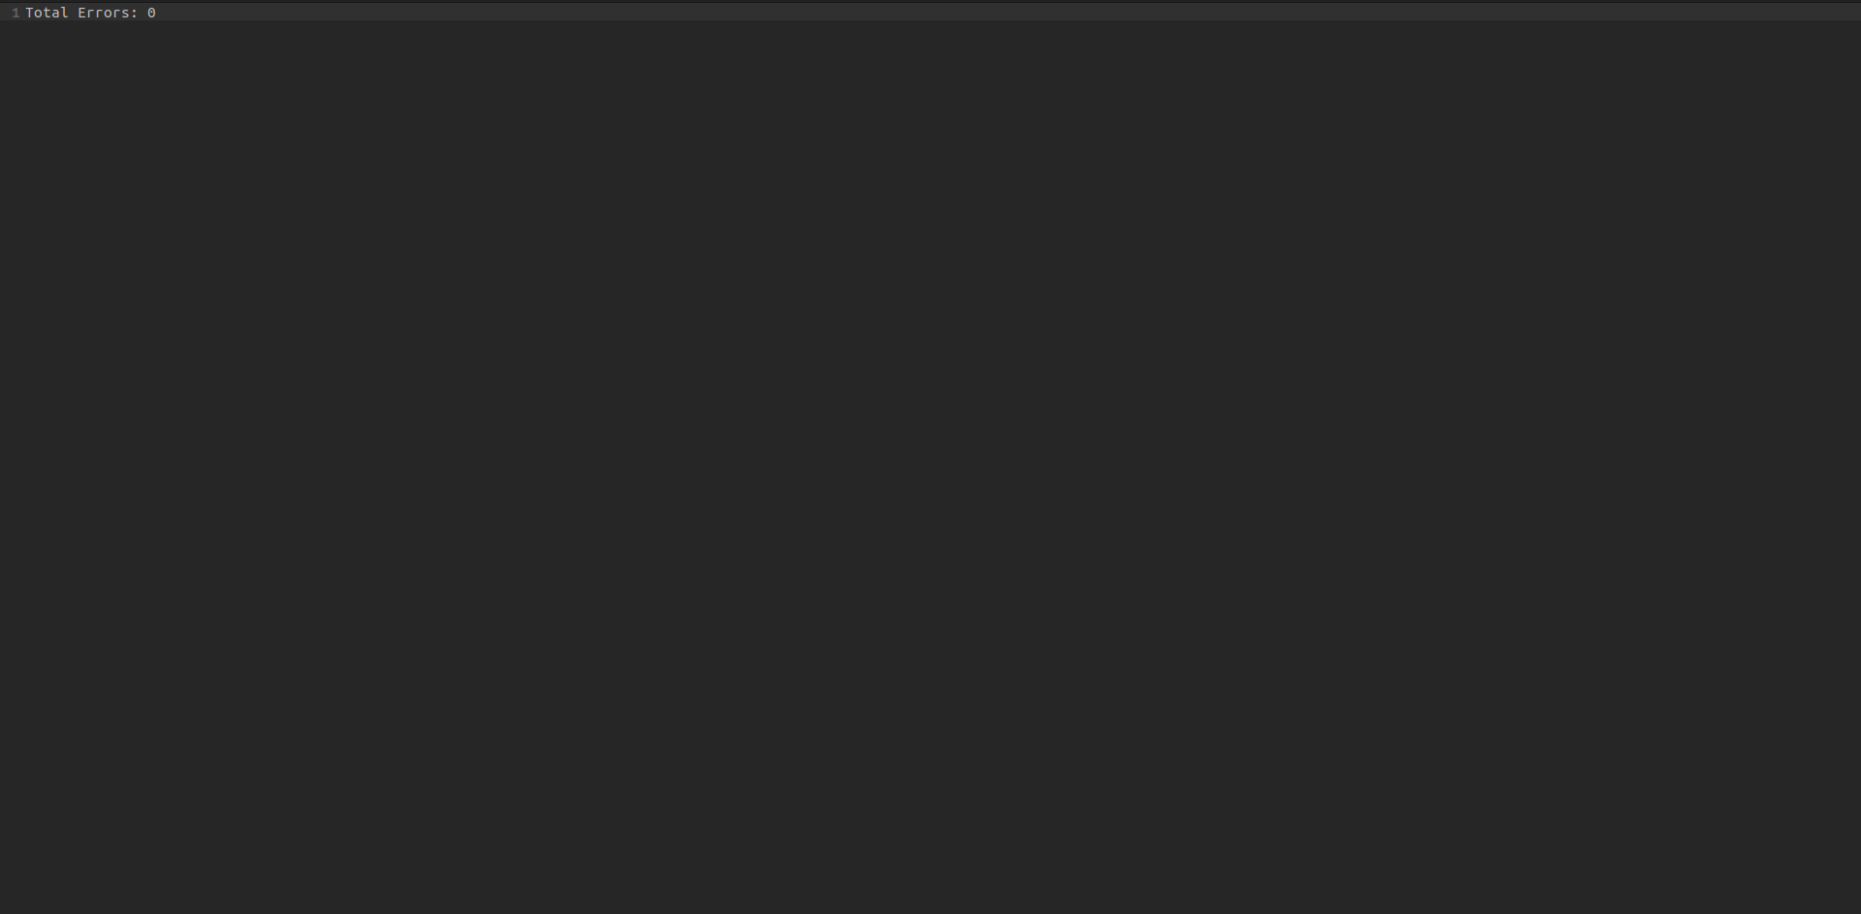
Static cmakelint test result : RGB Camera Grid-map Node
cmakelint errors
Post cmakelint correction

Slide 53
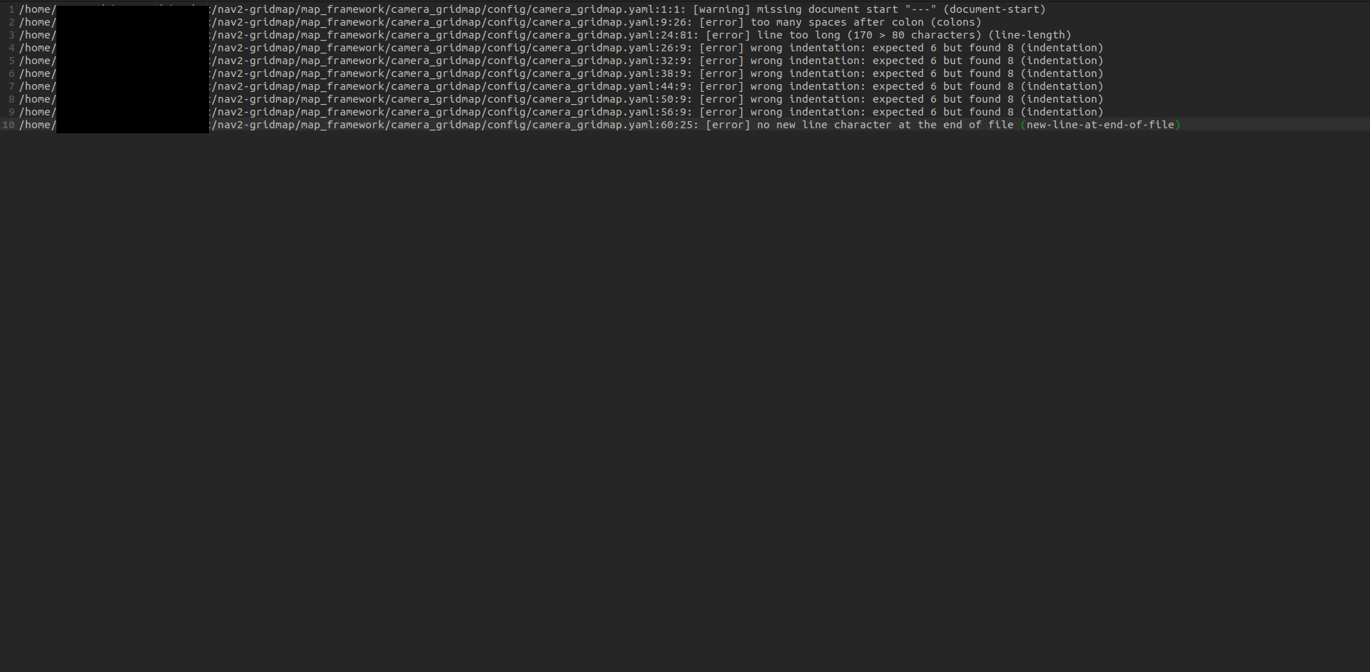
Static yamllint test result : RGB Camera Grid-Map Node
yamllint errors

Slide 54
Testing Framework on Tomcar
Tomcar System Configuration
PC-D pre installed dependencies
ROS2 - Foxy
Velodyne driver node
Zed2 camera node
GPS driver
PC-E pre installed dependencies
ROS2 - Foxy
Road Segmentation
PC-F pre installed dependencies
ROS2 - Foxy
Costmap framework dependencies
ROS2 - Humble
GridMap library
MongoDB Server
mongo-cxx-driver
graphicsmagick

Slide 55
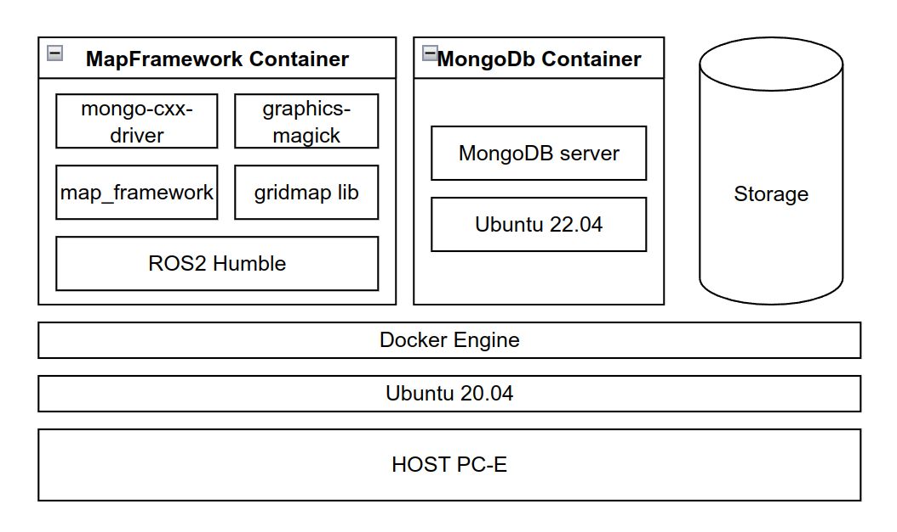
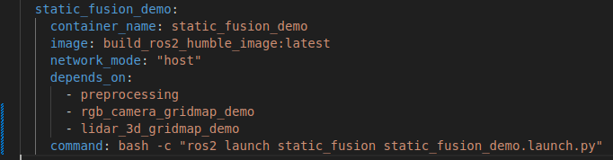
Testing Framework on Tomcar
Setup and Installation
As host system and map_framework dependency of ROS2 is not same, we containerised the whole framework in multistage image using docker.
Used docker-compose to configure containers mount points, command and network mode
We chose PC-F for setting up docker and deploying containers

Slide 56
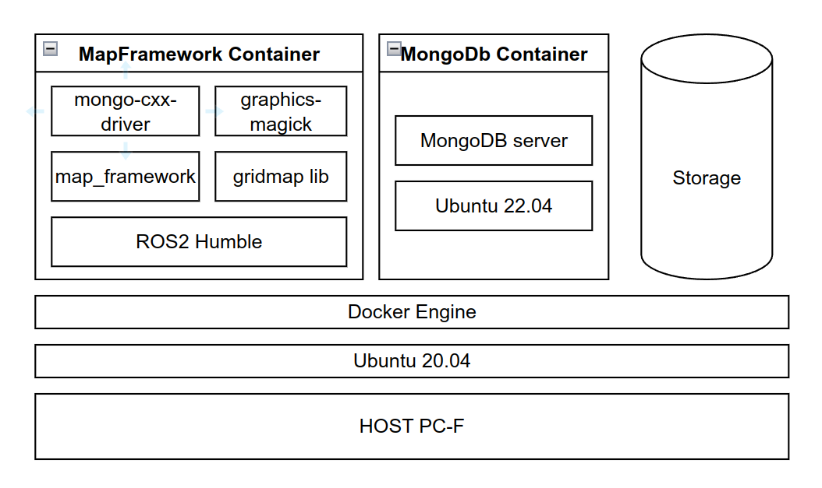
Testing Framework on Tomcar
Deployment Architecture
PC-D
Velodyne driver node
Velodyne PointCloud
Zed2 camera node
RGB Images
GPS localization node
Special Odometry
PC-E
Road Segmentation Node
Road PointCloud
NonRoad PointCloud
local network communication

Slide 57
Testing Framework on Tomcar
Issues faced in deployment and testing process
Issue | Cause | Fix
Topics not getting subscribed inside container | Tomcar network not reachable from docker container even after configuring container to use host network. | Configuring the container env variables - ROS_IP=192.168.x.x
TF getting old and Failed to sync “message_filters::TimeSynchronizer” | Incorrect system time in all systems | Setting datetime in PC-C and Resetting the chrony service
Getting error “RTPS_READER_HISTORY Error] Change payload size of '24' bytes is larger than the history payload size of '11' bytes and cannot be resized. -> Function can_change_be_added_nts” while calling mapstorage services | Payload size of service request should be within 11 bytes, this prevents the service call to server | Installing and configuring the cyclonedds inside container

Slide 58
Deliverables of Activity3
 | Name | Delivery
1 | A Complete source code (bug free) and executable packages incorporating changes done in Activity 2 along with supporting files and dependencies. | Delivered in the form of DVD on the 6th of November
2 | Static and Dynamic Test reports | Will be submitted post meeting

Slide 59
Dynamic Testing the Framework on Tomcar
Test Scenario | Test Name | Acceptance Criteria | Procedure | Pass/Fail
Environment Validation | COSTMAP_TEST01 | The ROS2 environment functions correctly with different nodes and interaction with the dataset. | Open the terminal and run the 'fusion' node using the launch command. | Yes
Parameter Change | COSTMAP_TEST02 | Changes in the parameters should reflect accurately in the system output without causing errors. | Change the parameters in the launch file and run the node. | Yes
Obstacle Representation | COSTMAP_TEST03 | The framework should accurately represent obstacles and their absence, displaying results in Rviz2. | - Run the CostMap from LiDAR node. - Verify the distance using grid resolution x number of grids in Rviz2. | Yes
Terrain Navigation | COSTMAP_TEST04 | The framework should correctly interpret terrain slopes determining navigability based on degree. | Use a terrain/road ROS bag and capture LiDAR and camera data. | Yes
Dynamic Obstacle Representation | COSTMAP_TEST06 | The framework should accurately represent and track dynamic obstacles, displaying results in Rviz2. | - Run LiDAR data and camera data. - Run the detection and tracking node - start dynamic camera gridmap node | Yes
Topic & Message Matching | COSTMAP_INT_TEST01 | All topics, services, and message types should match across all dependent nodes and fusion node. | - Start all static gridmap nodes - start static fusion node - Start dynamic camera gridmap node - Start detection and tracking node | Yes

Slide 60
Dynamic Testing the Framework on Tomcar
Test Scenario | Test Name | Acceptance Criteria | Procedure | Pass/Fail
Dynamic Obstacle Representation | COSTMAP_INT_TEST03 | The framework should correctly track dynamic obstacles and their trajectories. | - Start Object Detection and Tracking Node - Start Dynamic Lidar Gridmap node | Yes
Map Storage | COSTMAP_INT_TEST04 | The framework should save time-stamped images of the fused map at defined intervals and locations. | - Start MongoDB server - Start MongoDB Compass - Run Map Saver Node - Call the service to toggle storage - Launch the gridmap nodes | Yes
Map Retrieval | COSTMAP_INT_TEST05 | The framework should successfully import a map collage of all saved images associated with a mission. | - Start MongoDB Compass - Enter storage path for the mission - Launch RViz 2 to visualize stored maps | Yes
CPU/Memory Load | COSTMAP_TEST07 | The CPU and Memory load should remain within acceptable limits during system operation. | - Run static and dynamic fusion nodes - Run htop | Yes
Individual Sensor Visualization Test | COSTMAP_VIS_TEST_01 | The framework should represent individual sensor gridmaps | - Run static lidar and camera gridmap nodes - Run dynamic camera and lidar gridmap nodes - Launch RViz to view the gridmap layers | Yes
Static Fusion Gridmap Visualization Test | COSTMAP_VIS_TEST_02 | The framework should represent the fused gridmap for static obstacles | - Run static fusion nodes - Launch rviz to view fusion gridmap layers | Yes
CPU/Memory load | COSTMAP_TEST_07 | The CPU and Memory should be in acceptable limit. The update rate should be >=1.5hz | Run the fusion node with and without inputs. Check the update rate of fused topic. | Yes

